Slide 1
IP Essentials for commercial lawyers

Slide 3
Trade Mark
Registration for a distinguishing letter, word, device, shape, colour, sound, scent etc.
Business name
Company name
Domain name
S41, S44, S20 Trade Marks Act 1995
Self Care IP Holdings v Allergan Australia [2023] HCA 8

Slide 4
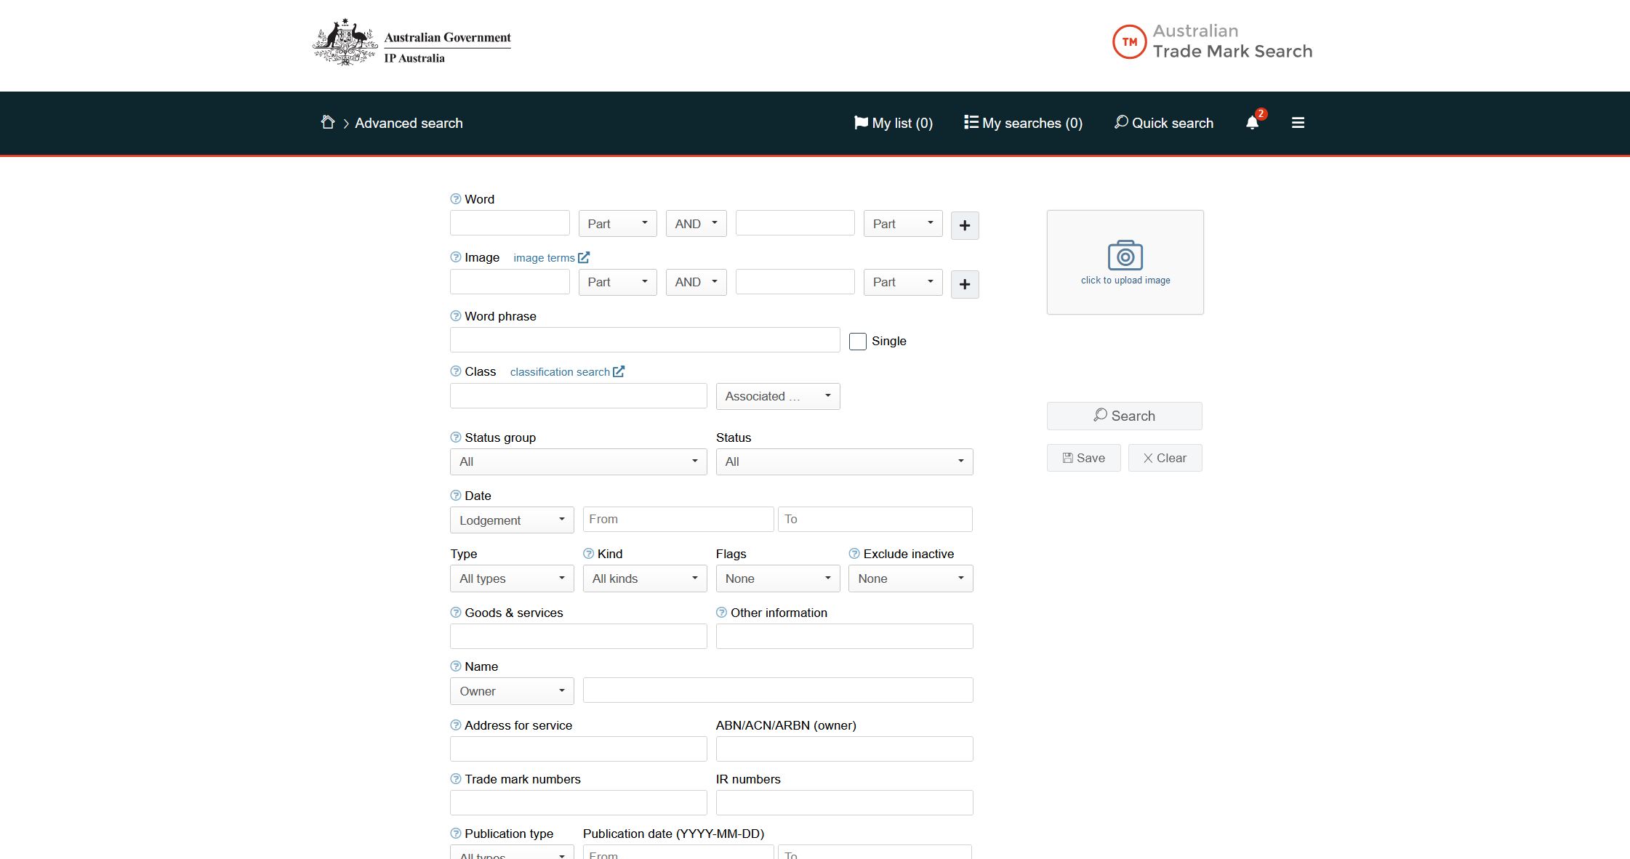
Notes:
Searching
Insights

Slide 5
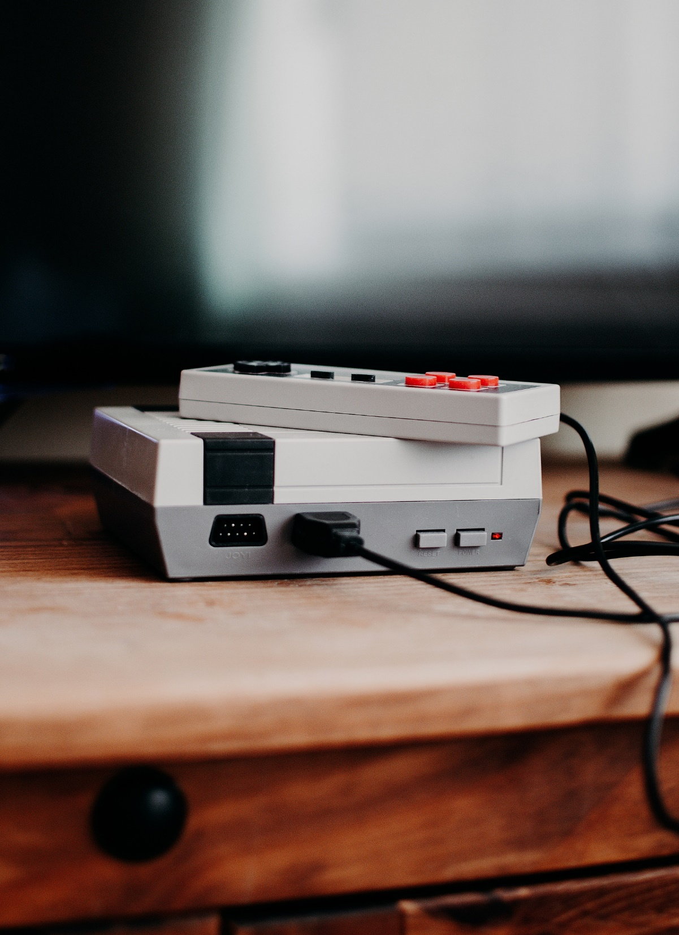
Patent
Registration for a device, substance, method or process that is new, inventive, and useful.
S7, S13, S18, Patents Act 1990
Research Affiliates LLC v Commissioner of Patents [2014] FCAFC 150, Commissioner of Patents v RPL Central Pty Ltd [2015] FCAFC 177, Aristocrat Technologies Australia Pty Ltd v Commissioner of Patents [2022] HCA 29

Slide 6
Design
Registration for the visual features of shape, configuration, pattern or ornamentation which give a product a unique appearance, and which is new and distinctive.
S10, S15 Designs Act 2003

Slide 7
Copyright
Protects original literary, dramatic, musical and artistic works, and sound recordings, films, radio and television broadcasts, and published editions.
S13, S14, S31 Copyright Act
Boomerang Investments Pty Ltd v Padgett [2020] FCA 535 (music)
Campaigntrack Pty Ltd v Real Estate Tool Box Pty Ltd [2022] FCAFC 112 (code)
Realestate.com.au Pty Ltd v Hardingham, RP Data Pty Limited v Hardingham [2022] HCA 39 (photos)

Slide 8
Design v Copyright Overlap Artistic work applied industrially: Copyright Act s74-s77A Designs Act s18 Burge v Swarbrick [2007] HCA 17 (yacht) State of Escape Accessories Pty Limited v Schwartz [2022] FCAFC 63 (tote)

Slide 9
Confidential Information
Knowledge or documents not in the public domain and shared under the expressed or implied obligation not to disclose it or its contents.
-
Smith Kline & French Laboratories (Aust) Ltd v Secretary Department of Community Services & Health (1990) 22 FCR 73

Slide 10
Owning
Employees – Patents Act s15(1); Copyright Act s35; Courier Pete Pty Ltd v Metroll Queensland Pty Ltd [2010] FCA 735
Joint owners – Patents Act ss16, 63; Trade Marks Act s27; Copyright Act s30, s78
Intention - Trade Marks Act s27; Pham Global Pty Ltd & Anor v Insight Clinical Imaging Pty Ltd [2017] FCAFC 83
First Use – Trade Marks Act s44, s58, s58A, s60, s122, s124
Non Use – Trade Marks Act s92; Lodestar Anstalt v Campari America LLC (2016) 244 FCR 557
Moral rights – Copyright Act Part IX

Slide 11
Licensing
Subject – whole or part, background, new; Colin CM Moore Pty Ltd V Sivathasan [2022] NSWSC 532
Scope – time, purpose, location, manner
Term – Maggbury Pty Ltd v Hefele Australia Pty Ltd (2001) 210 CLR 181; Patents Act s145
Royalties – calculation, reporting
Rights of exclusive licensee / authorised user –
Patents Act s103, s120
Trade Marks Act s8, s26
Copyright Act s117-125

Slide 12
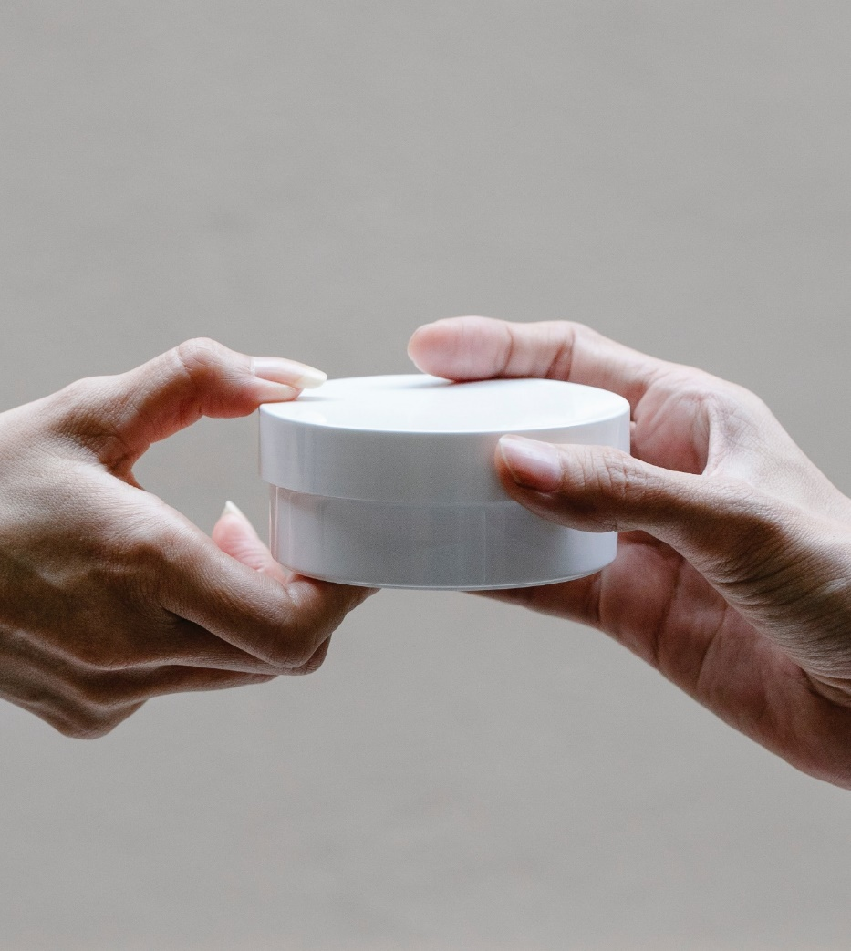
Transferring
In writing
Identifies the IP (and rights to sue: EIFY Systems Pty Ltd v 3D Safety Services Pty Ltd [2017] NSWSC 1310)
Identifies the parties
Signed by the parties
Recorded – Trade Marks Act s106-111; Patents Act s187, s196, Patents Regulation r19
Stamped? – Duties Act s35, s37, sched 6.

Slide 13
Enforcing
Unjustified Threats – Stone & Wood Group Pty Ltd v Intellectual Property Development Corporation Pty Ltd [2018] FCAFC 29
Additional damages:
Patents Act s122 – Pacific Enterprises (Aust) Pty Ltd v Bernen Pty Ltd [2014] FCA 1372 (window winder $40,000)
Trade Marks Act s126 – Taylor v Killer Queen, LLC (No 5) [2023] FCA 364 ($TBA)
Copyright Act s115(4) – Henley Arch Pty Ltd v Lucky Homes Pty Ltd [2016] FCA 1217 (house plan $25,000)
Collateral actions – Australian Consumer Law s18, s29, Passing Off; CI JI Family Pty Limited v National Australian Nappies (NAN) Pty Limited [2014] FCA 79; Pokémon Company International, Inc. v Redbubble Ltd [2017] FCA 1541

Slide 14
Donna Patane
Lawyer and Director, DRIPL
E: donna@dripl.com.au
P: 0407 966 347

